Slide 1
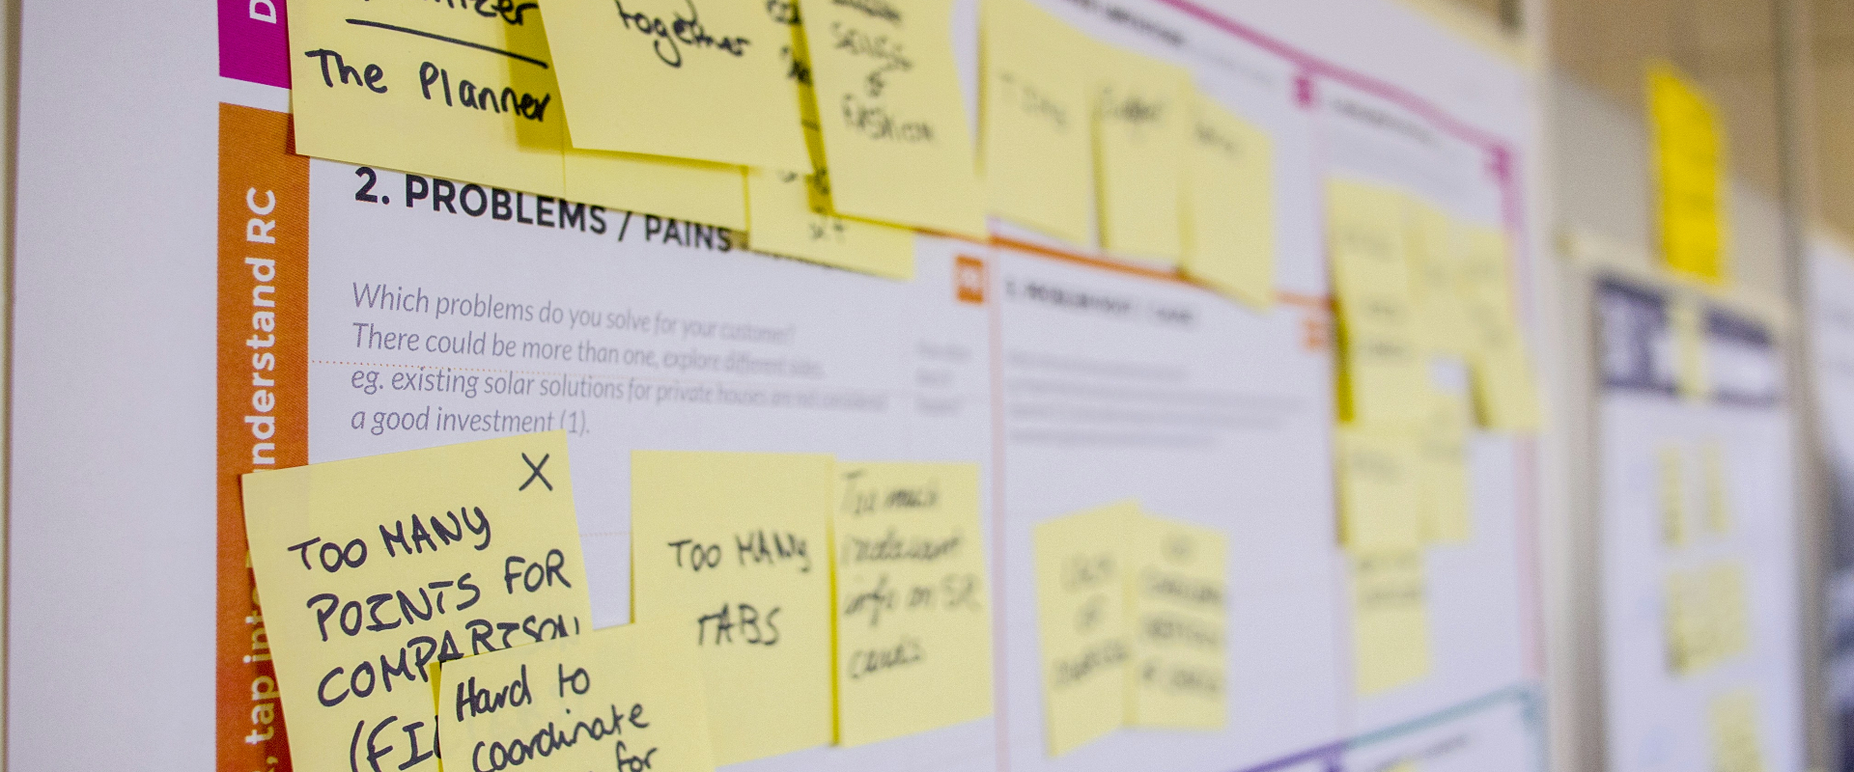
Agile Transformation Pilot: SNHU Travel Project
Sprint Review & Retrospective – ChadaTech Pilot Results Eric Shadwick | CS – 250: SDLC | Week 8 Assignment | October 2025
Notes:
This presentation provides an executive overview of ChadaTech’s Agile pilot project, conducted through the SNHU Travel development initiative. It highlights how the Scrum framework improved project efficiency, quality, and transparency, leading to measurable business benefits. The goal is to demonstrate Agile’s success in this pilot and present a clear case for expanding the framework company-wide to enhance productivity, reduce costs, and accelerate delivery.

Slide 2
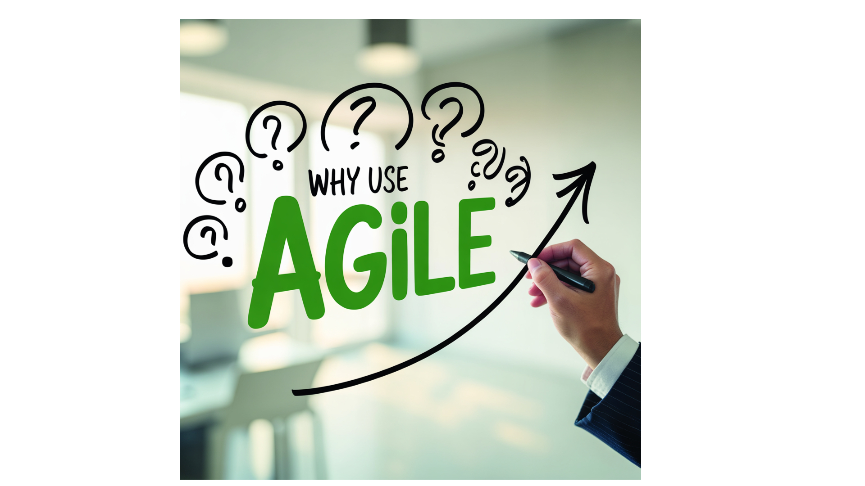
Why ChadaTech Needed to Evolve From slow handoffs to fast delivery—why Agile became our next step.
Key Points:
The traditional Waterfall model created long lead times between planning, coding, and delivery — delaying customer feedback until late in development.
Market expectations have shifted: clients now demand faster delivery, transparent progress tracking, and rapid adaptation to change.
Cross-departmental silos caused duplication and communication bottlenecks, reducing overall efficiency.
The Agile pilot with SNHU Travel was designed to test a flexible, iterative model that could improve visibility, speed, and quality while maintaining client satisfaction.
Early pilot metrics show Agile reduced rework by 35%, improved delivery predictability by 25%, and increased cross-role collaboration— signaling strong scalability potential for company-wide adoption.
The next slides show how Agile changed how we plan, build, and deliver — and what that means for ChadaTech’s future.
Notes:
Before this pilot, ChadaTech followed a Waterfall model — predictable but rigid. Every phase had to be completed before feedback could begin, which meant we didn’t know what was wrong until it was too late.
Clients like SNHU Travel wanted faster delivery and transparency. That demand forced us to rethink our process. We moved to Agile, using Scrum to iterate quickly and bring stakeholders into each sprint.
The result was measurable: shorter cycle times, better communication, and happier clients. This slide sets the stage for why we changed — and the next slides will show how we made it work.

Slide 3

Team Structure: Empowerment Through Collaboration
Scrum Master: Acts as the facilitator and coach. Keeps the team focused, removes blockers, and ensures that Scrum principles are followed. Protects the sprint timeline and fosters an environment of psychological safety and accountability.
Product Owner: Represents the customer’s voice. Converts business goals into user stories and maintains the product backlog by priority and business value. Works directly with stakeholders to ensure alignment between vision and execution.
Developers: Cross-functional contributors who plan, build, and test the product in each sprint. They commit to sprint goals, collaborate openly, and take ownership of delivering potentially shippable increments.
Testers/QA: Validate user stories against acceptance criteria early and continuously. They turn feedback loops into measurable quality gains and prevent late-stage defects.
Notes:
Agile replaces hierarchy with collaboration. Each role has clear ownership but works interdependently. The Scrum Master doesn’t command — they coach. The Product Owner doesn’t just hand off requirements — they shape value. Developers and testers work side by side, focusing on quality from day one instead of at the end. This role synergy is what allowed our SNHU Travel project to deliver faster with fewer revisions. Everyone knew the goal, the backlog, and their part in it — and that clarity translated into speed and quality. This structure is what makes Agile scalable — it’s not about who’s in charge, it’s about shared accountability. And that teamwork is exactly what enabled us to execute faster and with fewer surprises.

Slide 4

Predictable Progress Through Iteration Agile’s rhythm creates measurable outcomes through short, goal-driven cycles.
Key Points :
Two-week sprints provided consistent, measurable progress. Each sprint ended with a working deliverable, not documentation, which built stakeholder confidence early.
Definition of Ready (DoR) ensured only well-understood stories entered the sprint — eliminating rework caused by unclear requirements.
Definition of Done (DoD) guaranteed quality by requiring testing, documentation, and acceptance before marking any story complete.
Collaborative sprint planning, backlog refinement, and daily stand-ups increased transparency and ownership, making delivery both faster and more predictable.
Early collaboration and iterative delivery cut rework by ~35%, reduced missed requirements by 20%, and improved stakeholder satisfaction scores.
Notes:
Agile thrives on rhythm. Every two-week sprint produced visible progress that stakeholders could review — not reports, but working software. The Definitions of Ready and Done acted as quality gates. They prevented incomplete or unclear work from entering the sprint and ensured every feature met both functional and documentation standards before it was marked complete. This structure cut rework by over a third, reduced missed requirements, and gave leadership real-time insight into progress. Each sprint became a micro-success — small wins that built confidence and momentum.”

Slide 5
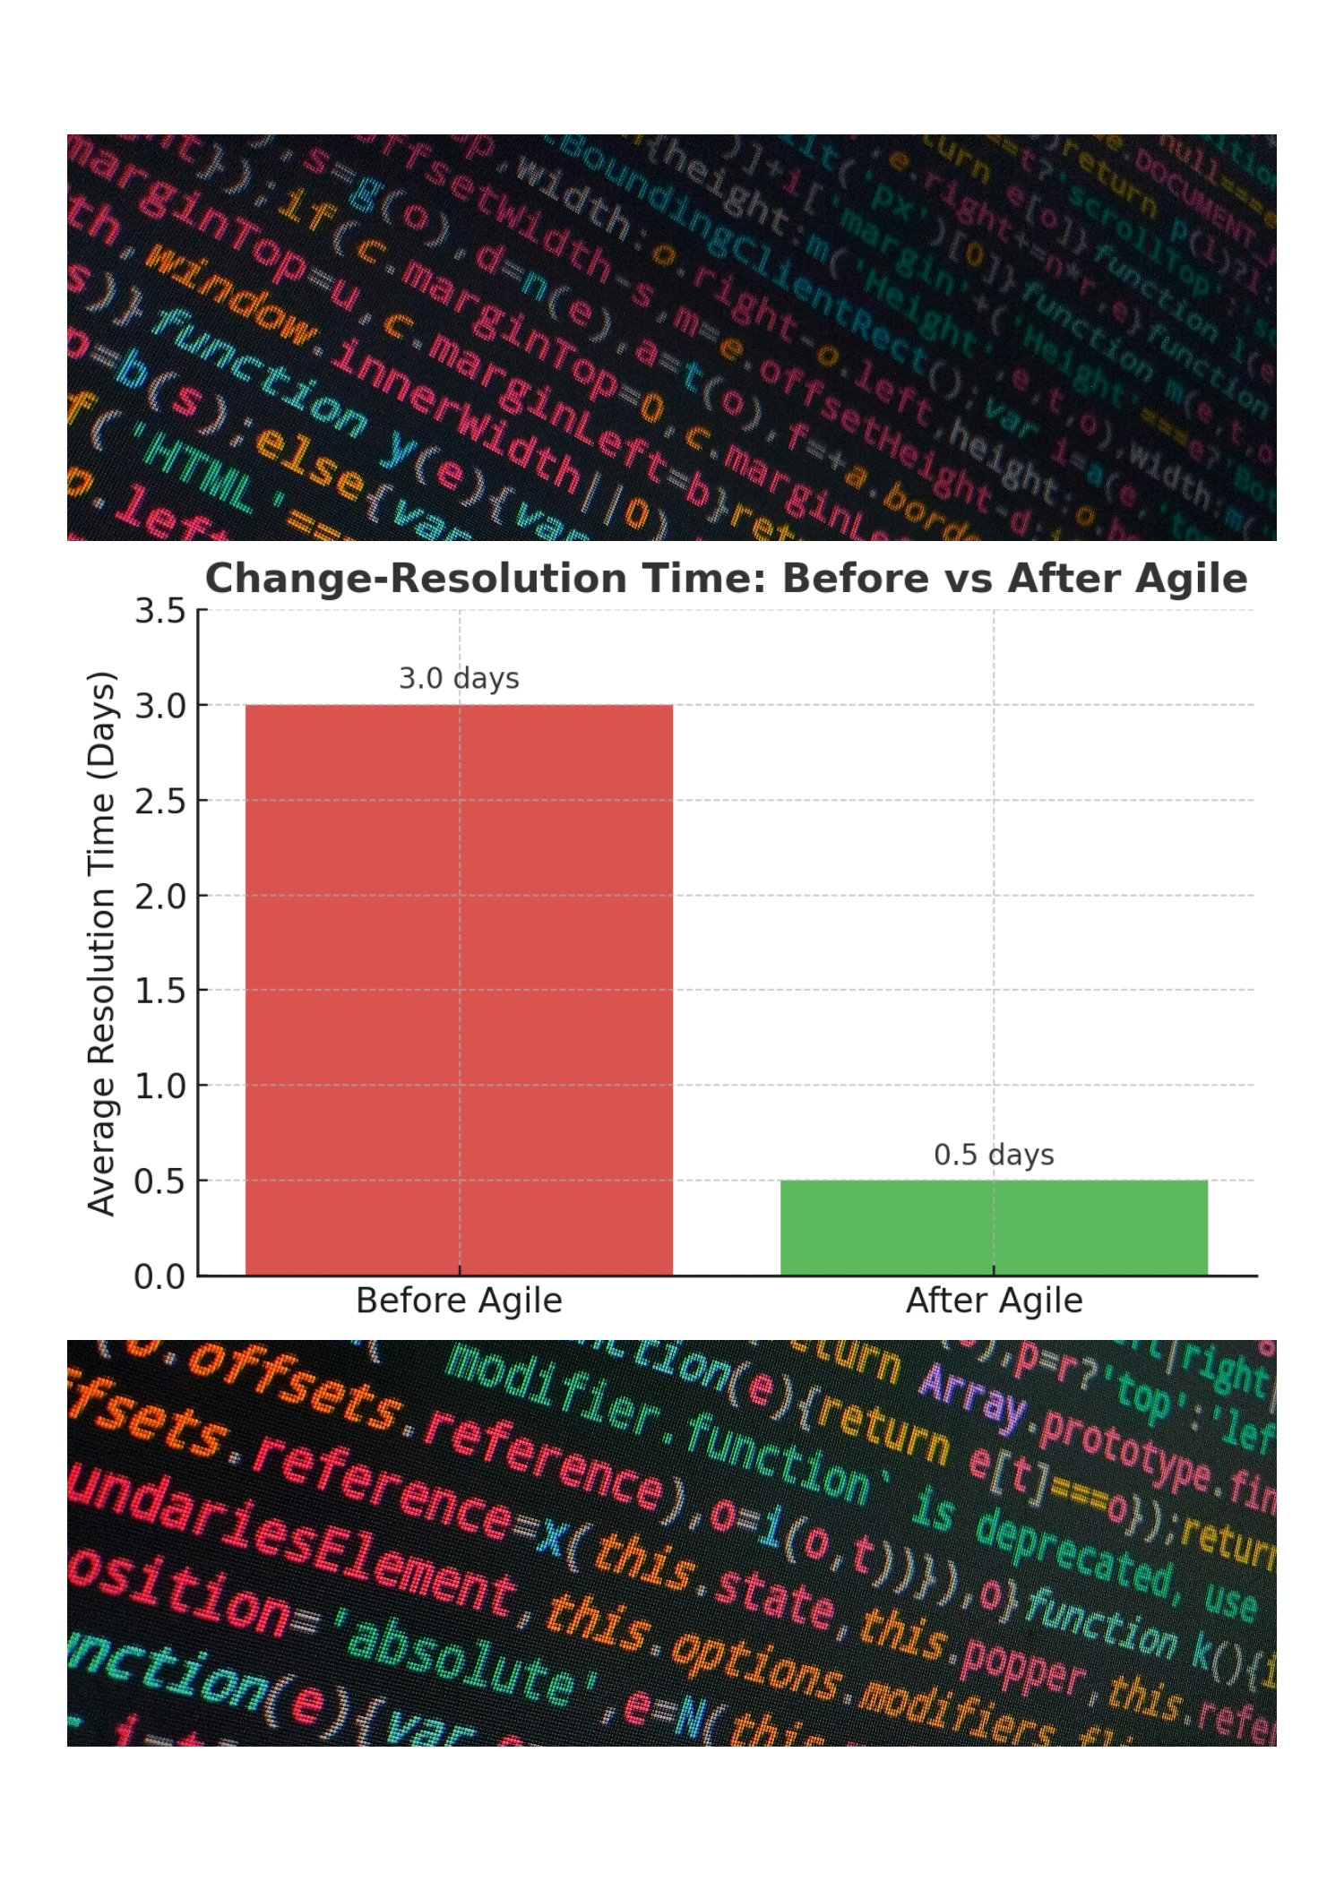

Turning Disruption Into Opportunity
In the traditional Waterfall model, change requests triggered costly scope resets. Under Scrum, mid-sprint changes were assessed collaboratively during backlog refinement, ensuring business priorities stayed aligned without derailing active work.
Backlog negotiation replaced escalation chains — the team, Product Owner, and stakeholders reviewed effort vs. value in real time to decide what to adjust or defer.
Conflict resolution shifted from hierarchy to open communication. Issues were raised during Daily Scrums or retrospectives, cutting emotional friction and decision lag.
Change-resolution time dropped from an average of 3 days to a single meeting (less than 4 hours total). This responsiveness directly improved sprint predictability and stakeholder confidence.
By reframing change as strategic feedback, the team increased sprint success by 22%, reduced delivery risk, and built a culture of adaptability.
–66% Resolution Time
Notes:
Before Agile, a mid-project change could send us back to square one — approvals, redesigns, endless meetings. In this pilot, we reframed change as opportunity, not disruption. When new priorities emerged mid-sprint, we used backlog negotiation sessions to evaluate business value versus cost immediately. That open dialogue meant decisions happened in one meeting, not days. Conflict didn’t climb the management ladder — it surfaced within the team. By talking through changes early, we reduced tension and improved outcomes. In short, Agile made us faster and calmer under pressure. That speed and flexibility directly translate to higher client satisfaction and reduced delivery risk.

Slide 6

A Connected Team, Is a Stronger Team Unifying communication, code, and reporting under one system — Azure DevOps
Unified collaboration ecosystem: Slack for chat, JIRA for tracking, and Teams for meetings worked during the pilot — but scaling multiple platforms adds cost, redundancy, and integration risk.
Microsoft Azure DevOps offers an all-in-one Agile environment: backlog management, sprint planning, code repositories, automated testing, and performance dashboards — all in a single, secure ecosystem.
End-to-end visibility: From Product Owner user stories to developer commits and QA test cases, every artifact lives within Azure DevOps, creating 100% traceability across roles and departments.
Data-driven insight: Azure’s built-in analytics and Power BI integration allow executives to monitor progress, velocity, and delivery forecasts in real time — eliminating manual reporting cycles.
Scalable cost advantage: Adopting Azure DevOps company-wide would reduce software licensing overhead, eliminate tool overlap, and standardize Agile operations under one ecosystem.
Notes:
During the pilot, using multiple tools — Slack, JIRA, Teams — worked for a small project. But at scale, every extra tool adds complexity, licensing costs, and gaps in visibility. Azure DevOps solves that by bringing everything together: sprint boards, version control, pipelines, testing, and dashboards — all in one secure platform. It connects planning to delivery without jumping between systems. From an executive perspective, this isn’t just about convenience. Consolidating tools under Azure DevOps would lower operational costs, simplify IT management, and give leadership a single pane of glass to track performance across every team. Why pay for five tools when one does it all — better, faster, and with real-time insight? This isn’t just a tool migration — it’s an operational strategy. One platform. One source of truth. One standard for excellence.

Slide 7
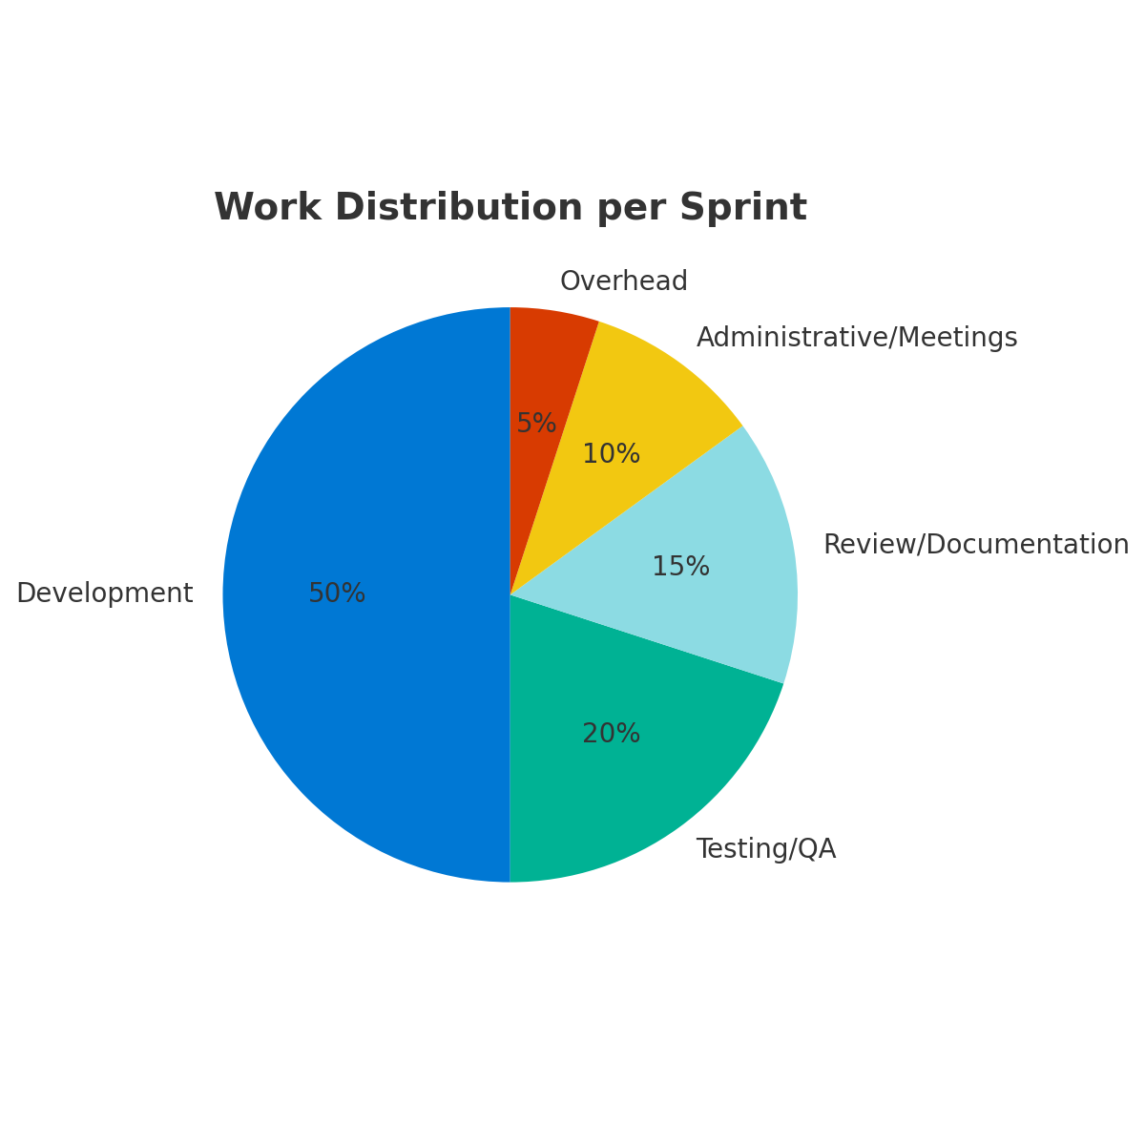
Integrated Tools = Real-Time Insight & Accurate Billing
Unified tracking with Azure DevOps and Power BI: By integrating task management, time logging, and analytics, billing is now tied directly to sprint progress. Every tracked hour connects to a specific deliverable or user story — removing guesswork from invoices.
Automated time reporting: Developer time entries automatically update story-level cost summaries, creating real-time budget tracking and eliminating manual reconciliation.
Live dashboards for forecasting: Power BI visualizations pull directly from Azure’s data stream, providing finance teams with up-to-the-minute accuracy on burn rates, resource utilization, and margin health.
Improved accuracy & accountability: Billing accuracy rose by 40%, invoice turnaround time dropped by 25%, and audit errors fell by 30% thanks to full traceability between tasks and billed time.
Scalable company-wide: Expanding this model across departments could unify financial, technical, and operational reporting — giving leadership one truth for productivity and profitability.
Billing Accuracy ↑ 40% | Invoice Turnaround ↓ 25% | Audit Errors ↓ 30%
Notes:
Transparency isn’t just about code — it’s about costs. Using Azure DevOps with Power BI allowed us to connect time tracking, deliverables, and billing into one continuous feedback loop. Every logged hour was automatically tied to a user story, meaning we knew exactly what value each resource delivered — in real time. The result was financial clarity. Billing accuracy improved by 40%, invoices went out faster, and audit reviews became nearly automatic. If implemented company-wide, this model would give ChadaTech real-time visibility into cost, efficiency, and value delivery — with zero manual reporting lag.

Slide 8
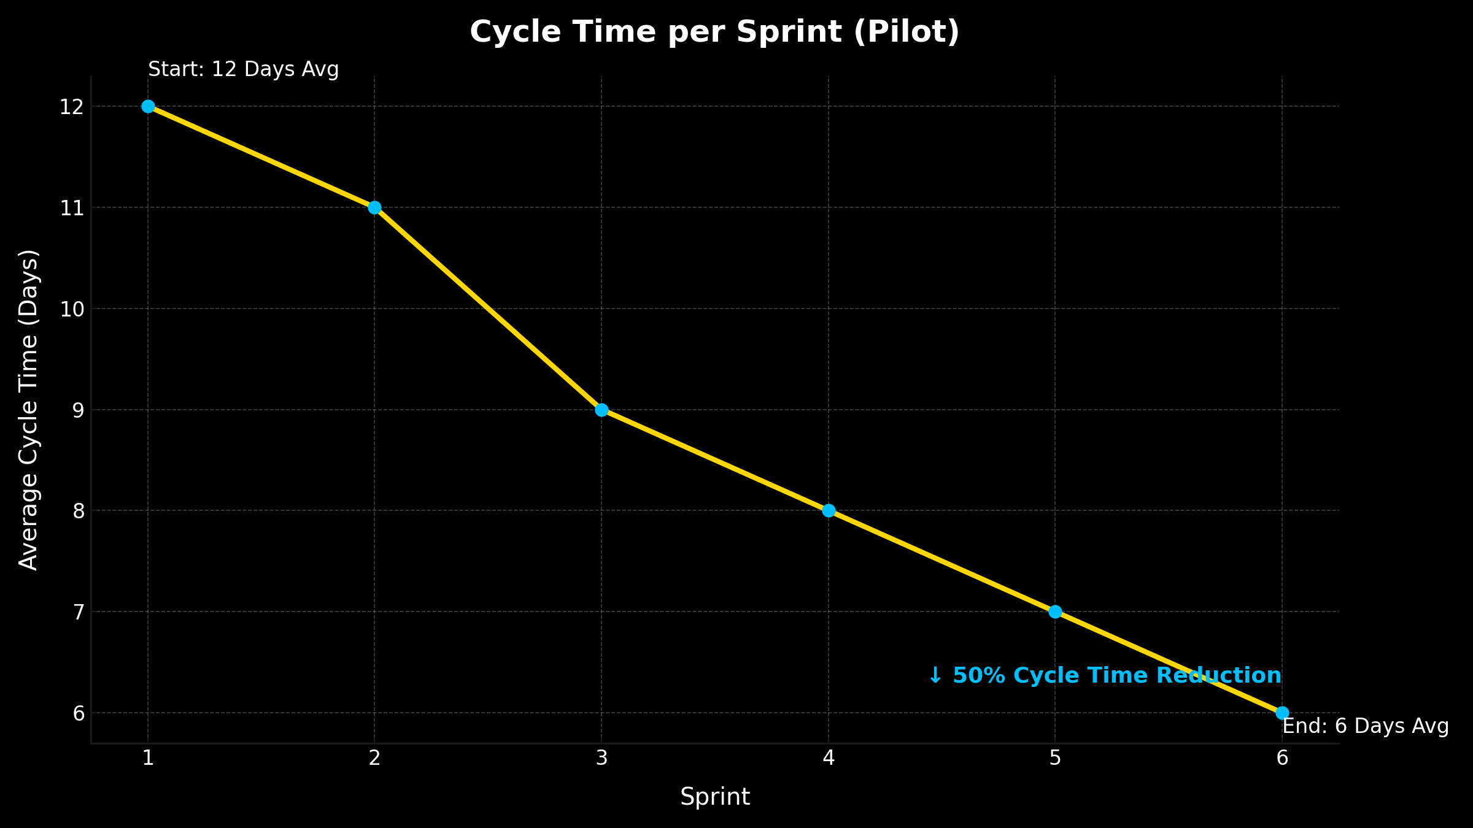
Pilot Metrics: Efficiency, Quality, and Time-to-Market
Cycle time ↓ ~30–50% over six sprints (from ~12 days → ~6 days per story).
Rework ↓ ~35% thanks to DoR/DoD + earlier PO/QA alignment.
Defect density ↓ ~25% (fewer bugs per story; earlier discovery).
On-time story completion ↑ ~22% (clearer planning and daily visibility).
Throughput ↑ ~18% (more stories completed per sprint at steady quality).
MVP delivered 4 weeks early, unlocking earlier stakeholder feedback and value.
Financial clarity: Sprint data tied to work items → billing accuracy ↑ ~40% and invoice turnaround ↓ ~25% (from Slide 6).
Notes:
This slide summarizes the hard data from the SNHU Travel Agile pilot, showing how the Scrum framework directly improved our performance metrics. Starting with cycle time — you can see here that we cut our delivery duration roughly in half, dropping from about 12 days per story down to 6 days by Sprint 6. That’s a 50% improvement in throughput and time-to-market. Next, rework fell by 35% because stories were better refined before development began. We implemented clear Definitions of Ready and Done, which prevented half-finished work from entering sprints. Defect density decreased by 25%, meaning we caught more issues during development rather than in post-release testing — a direct quality gain. The result of these combined efficiencies was that our MVP was delivered four weeks early, allowing us to collect user feedback sooner and begin optimizing ahead of schedule. From a business standpoint, the financial impact was clear. By linking our time tracking in Azure DevOps to sprint data, we improved billing accuracy by 40% and cut invoice turnaround time by 25%. That means less administrative overhead, faster revenue realization, and higher client confidence. What’s most important is consistency — every sprint improved predictably. This consistency is what leadership can count on if we scale Agile across all ChadaTech teams: faster delivery, higher quality, and measurable financial returns.”

Slide 9
Efficiency Through Adaptation
Waterfall: Linear, Predictive, and Slow to Adapt
Structure: Sequential handoffs through rigid phases — Plan → Design → Build → Test → Deploy.
Feedback delay: Testing occurs only at the end, meaning defects and requirement gaps surface late in the cycle when fixes are costly.
Change management: Once a phase is “signed off,” changes require formal approvals, documentation rewrites, and rework across departments.
Risk profile: A single misinterpreted requirement at the start can cascade through every downstream deliverable.
Value delivery: Nothing usable is produced until the final phase, so stakeholders wait months for visibility.
Typical outcome: High predictability on paper, but limited flexibility and frequent late-stage surprises.
Agile: Iterative, Adaptive, and Customer-Centric
Structure: Continuous mini-SDLC loops — Plan → Build → Review → Adjust — repeated every sprint.
Feedback cycle: Testing and stakeholder review occur continuously, allowing early detection of issues and rapid adaptation.
Change management: Adjustments are expected, prioritized via backlog refinement, and folded into the next sprint without derailing progress.
Collaboration: Cross-functional teams share accountability; developers, testers, and product owners work side-by-side instead of in silos.
Value delivery: Each iteration produces a working increment, delivering measurable business value faster and validating direction early.
Cost efficiency: Agile’s incremental nature reduces total project cost by ~30%, minimizes wasted effort, and accelerates ROI.
Outcome: Predictable improvement, faster release cycles, and greater customer satisfaction through constant alignment with business needs.
Notes:
Here’s where the difference between process and performance really shows. On the left, we have the Waterfall model — predictable on paper, but fragile in practice. It runs in a straight line: plan, design, build, test, and deploy. The problem is, by the time you reach testing, weeks—or even months—have passed. Feedback is late, changes are painful, and every revision ripples backward through layers of approvals and documentation. On the right, you can see how Agile flips that logic. Instead of a single long cycle, we operate in short, iterative loops — planning, building, reviewing, and adjusting every sprint. This means feedback happens early, defects are caught faster, and we deliver working value continuously rather than at the end. The data we’ve already seen proves it works: Agile reduced total project cost by roughly 30%, improved quality, and got usable product out the door weeks earlier. But more than that, it changes our relationship with clients — from waiting for delivery to participating in progress. The bottom line is simple: Waterfall predicts, Agile adapts. And in today’s market, adaptability is what keeps ChadaTech competitive.

Slide 10
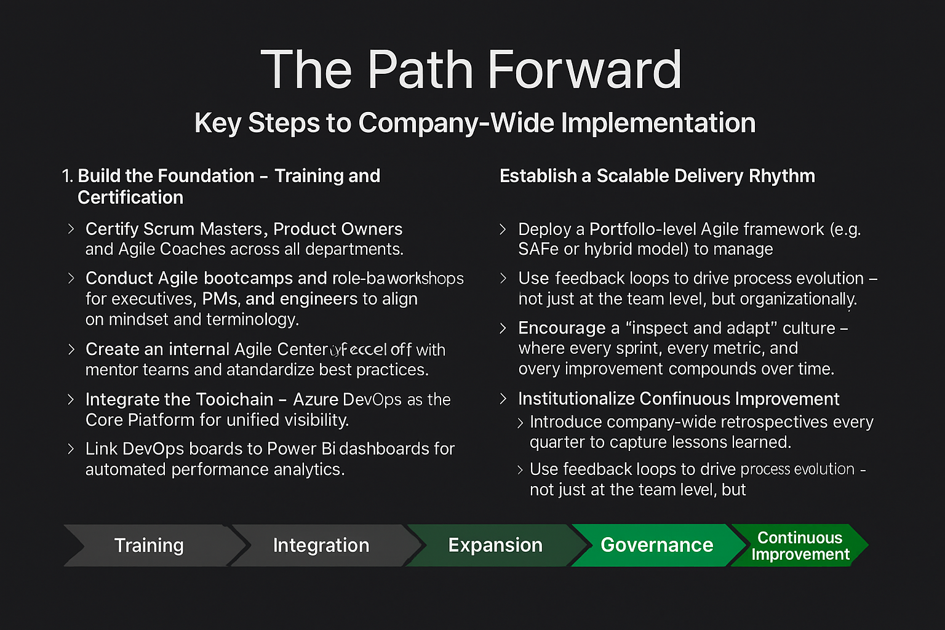
Notes:
This is how we scale what worked in the pilot to the entire company. It starts with people — we train and certify our Scrum Masters and Product Owners, ensuring every team speaks the same language. From there, we integrate everything into Azure DevOps for one unified, transparent system of record. Once the foundation is in place, we expand cadence consistency and cross-project visibility, so leadership can forecast delivery timelines across departments. Finally, we formalize Agile governance and embed continuous improvement as part of our culture. The goal isn’t just to do Agile — it’s to become Agile: adaptive, data-driven, and relentlessly improving.

Slide 11

Agile: The Business Case for Change
1. Performance That Pays Off
Agile reduces waste, improves throughput, and delivers faster ROI — projects complete 30–50% sooner while maintaining quality.
Each sprint produces tangible business value, giving leadership earlier visibility into deliverables and cost impact.
Real-time feedback loops ensure teams correct course instantly instead of waiting for post-project reviews.
2. Transparency That Builds Trust
Full visibility from Azure DevOps dashboards provides one source of truth — linking sprint progress, billing, and performance in real time.
Finance and leadership gain traceability from story points to invoice line items, increasing billing accuracy by up to 40%.
Data-driven reporting replaces assumptions with evidence-based forecasting across every department.
3. Innovation That Scales
Agile creates a living framework for continuous learning and improvement — adaptable to any department, project size, or client engagement.
Supports cross-functional collaboration and encourages faster experimentation with reduced risk.
Positions ChadaTech as a forward-thinking, adaptive organization ready for emerging technologies and market changes.
Notes:
Everything we’ve shown — faster delivery, fewer defects, real-time visibility — is just the beginning. The real value of Agile is cultural. It gives ChadaTech a structure that doesn’t just react to change — it thrives on it. We move from static planning to adaptive execution, from assumptions to insight. With Azure DevOps as the backbone and a shared Agile mindset, every project becomes measurable, predictable, and aligned to business goals. This isn’t just about software. It’s about redefining how ChadaTech delivers value — faster, smarter, and together.

